Slide 1
Homelessness Rates in the U.S.
By Long Tran-Thien

Slide 2
Introduction
Can we predict the rate of homelessness from certain factors on the local housing market such as rate unemployment, rates of different demographics, city or urban, and more in different areas of the U.S.
Questions to ask:
What columns are predictors in the model?
How well does a multiple linear regression model fit the full data set?
What predictors are important?

Slide 3
The Data
The U.S. Department of Housing and Urban Development (HUD) produced a report in 2019 Market Predictors of Homelessness that describes a model-based approach to understanding of the relationship between local housing market factors and homelessness.

Slide 4
Analysis Methods
Regression models/Results
Lasso
Ridge
XGBoost

Slide 5
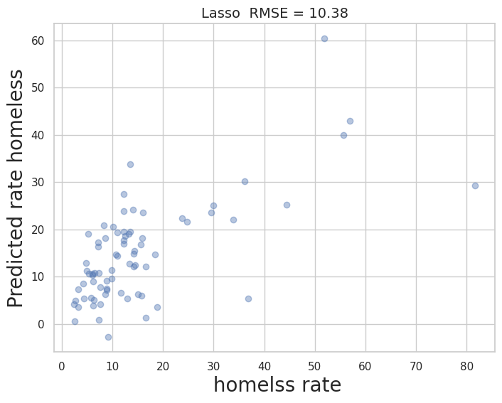
Lasso Regression

Slide 6
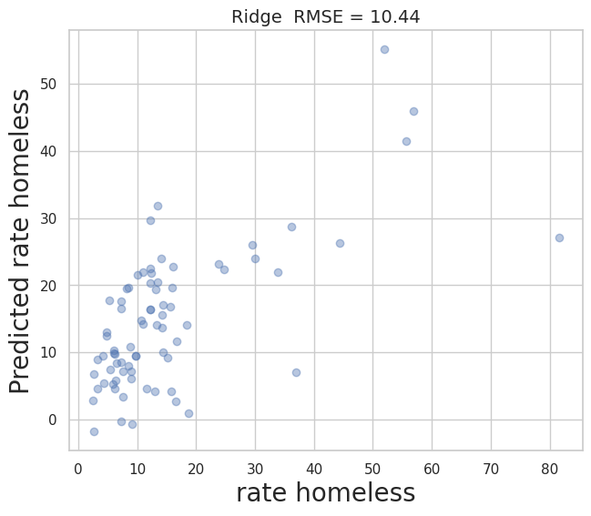
Ridge Regression

Slide 7
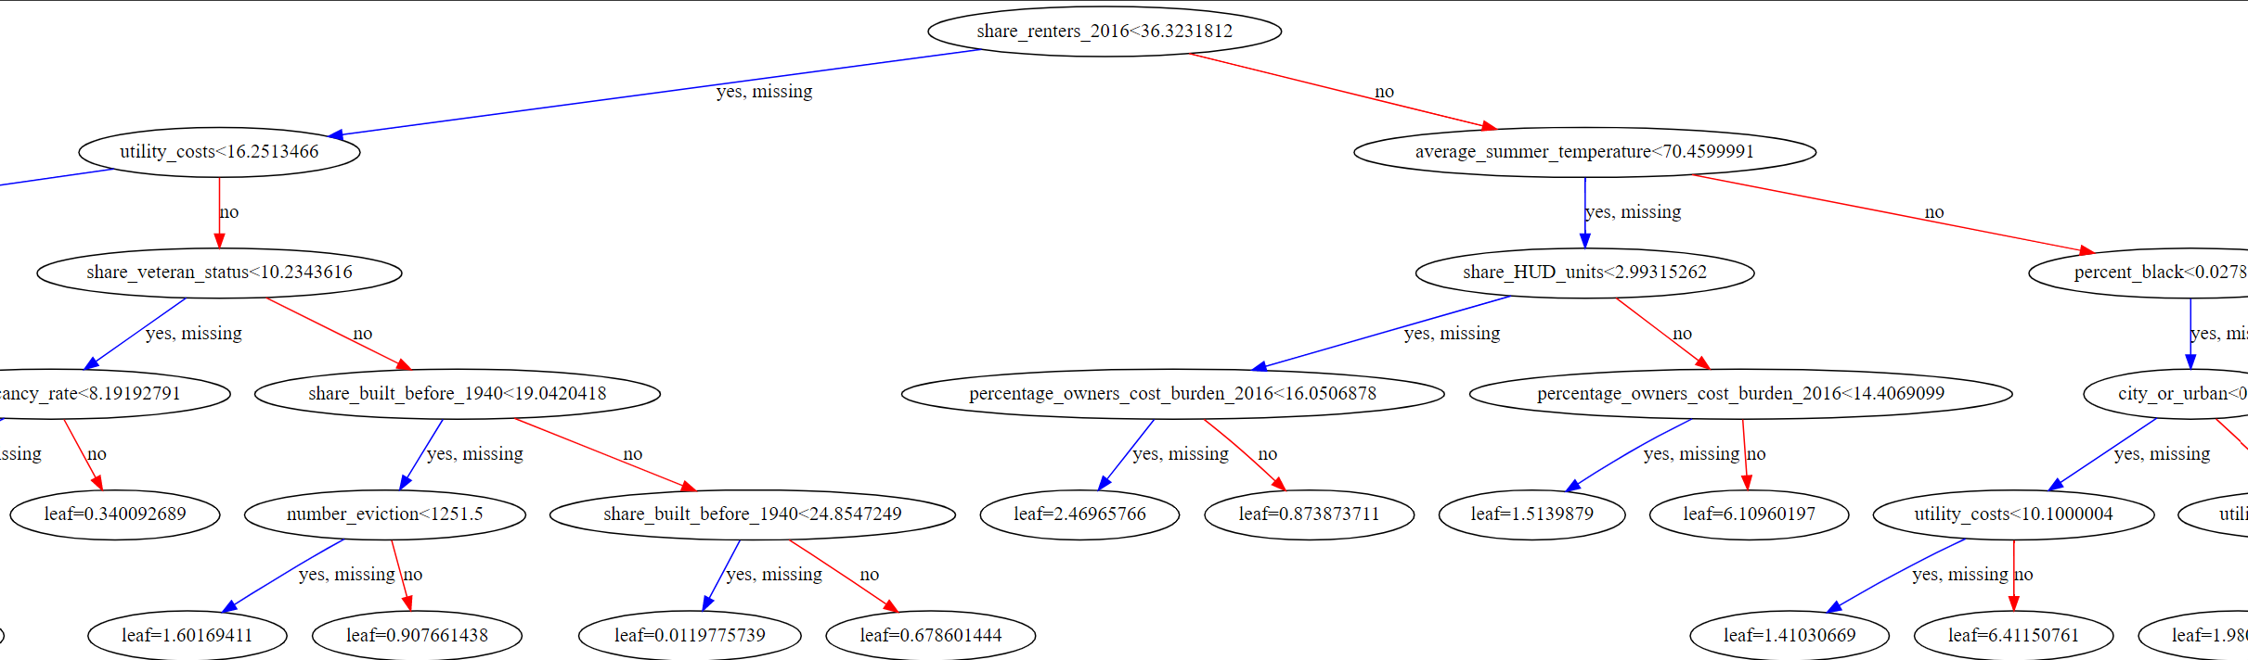
XGBoost

Slide 8
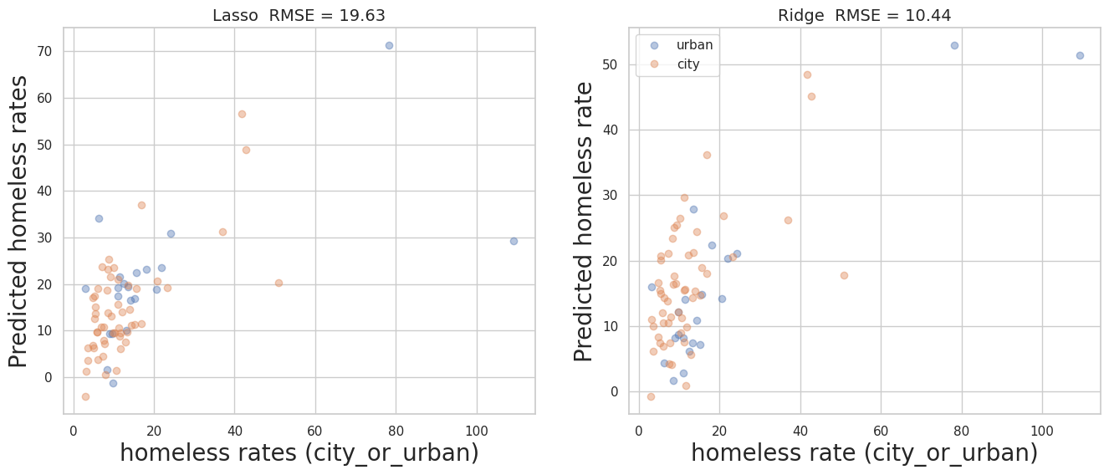
Lasso/Ridge Regression for addition step (city_or_urban)

Slide 9
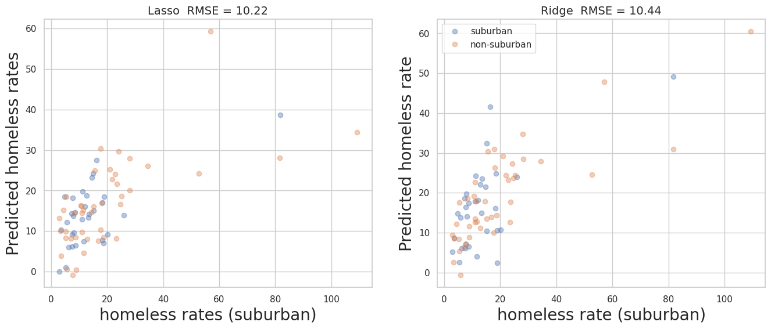
Lasso/Ridge Regression for addition step (suburban)

Slide 10
Conclusion
The overall aim of this project was to see how well or in correct terms, how accurate can we predict homeless rates. Overall, with changing the data to only include 2017 data and no other years, this makes our data very small to make an accurate prediction with. At most with using lasso, ridge regression and XGBoot, we would only get around 10%-20% accuracy in predicting homeless rates. This just goes to show how important it is to have a large data to help with prediction. if this was simply to show data, it would be fine, but prediction require much more.

